Slide 1
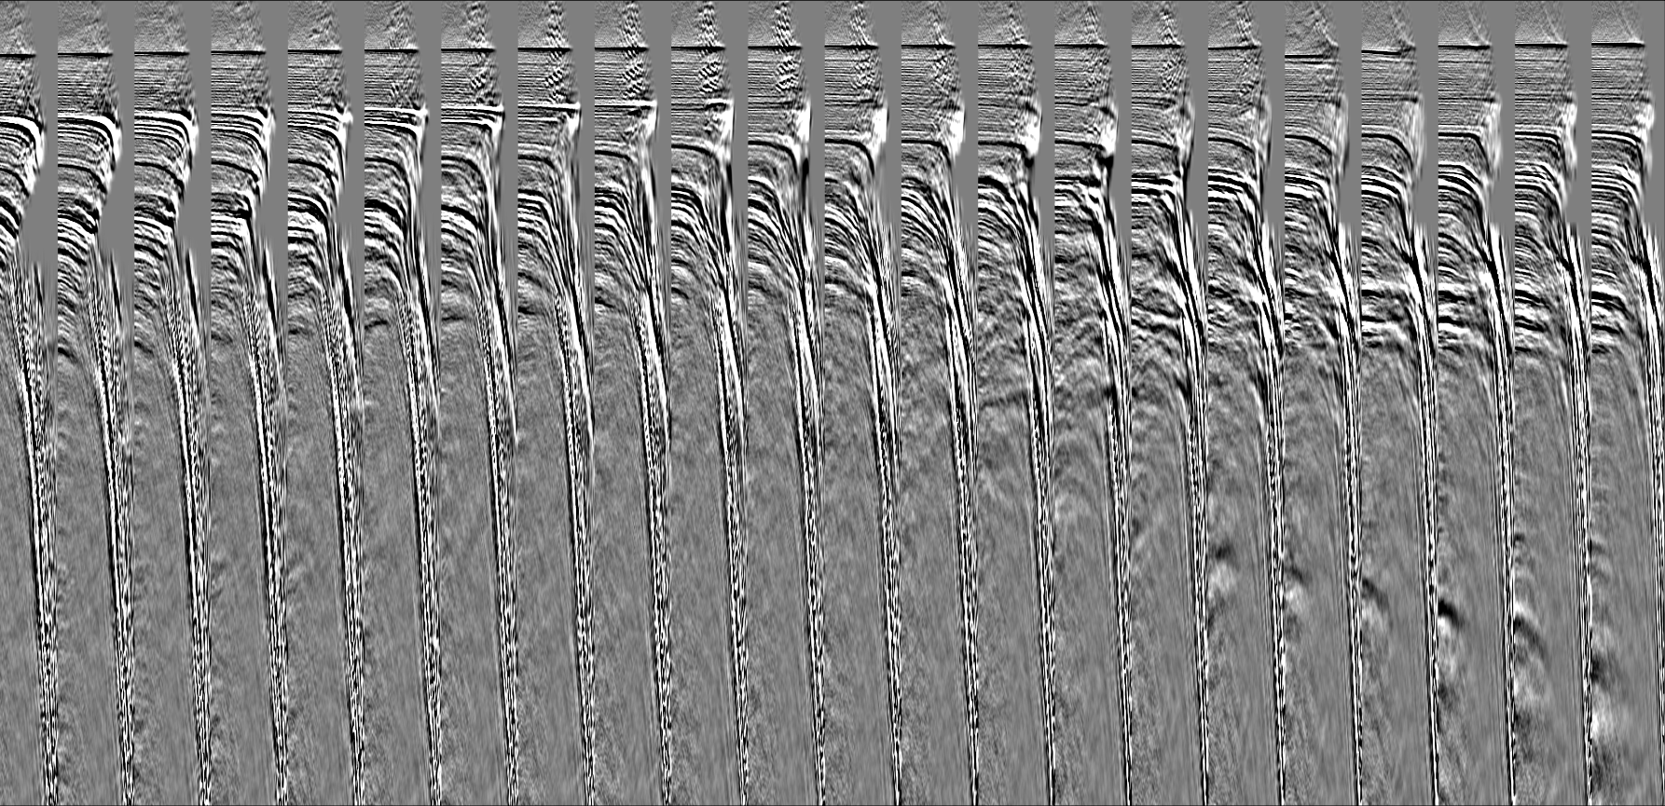
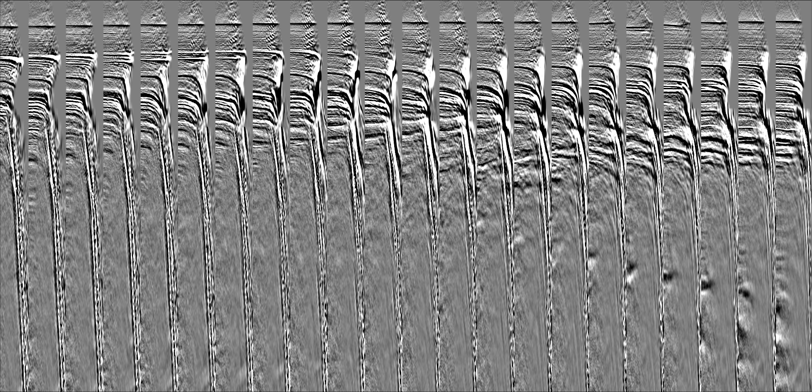


Extended Source Inversion: a potential alternative to LF FWI W. Symes (Rice), M. Dolliazal, R. Nammour, P. Williamson (TotalEnergies)
Inversion with extended source: access kinematic info in HF data w/o picking
Surface Source Extension – source energy spreads over 2D surface – fit any data with any velocity!
Data misfit + penalty for energy spread beyond acquisition footprint: forces velocity to match data kinematics
Examples: 2D synthetic, 3D marine
Sketch of theoretical justification
Limitations, prospects
FWI. SSE

